Slide 1

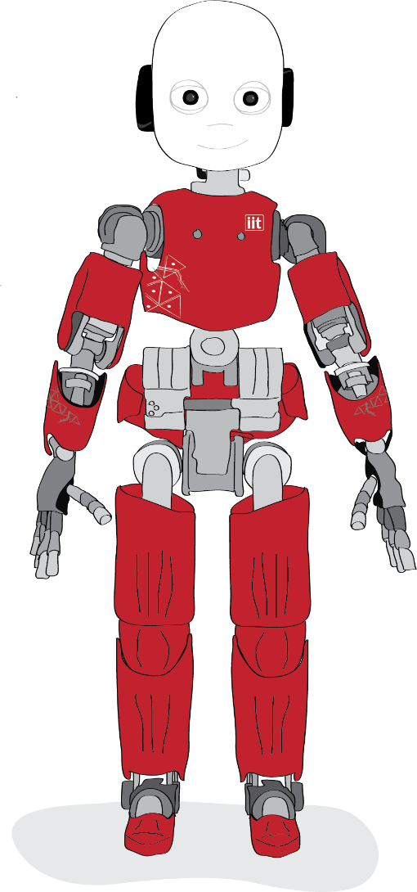
Choose Your Own Adventure
Social Engineering
Interactive Story
Dario Pasquali

Slide 2
Research Questions
A
Is possible to predict the choice of a risky option based on biometrical features?
B
The magnitude of the biometrical response is proportional to the perceived risk?
C
Can an external agent persuade the player to change his mind?
D
Does the embodiment and/or the physical presence of the agent change its persuasion ability?

Slide 3
Research Questions
A
Is possible to predict the choice of a risky option based on biometrical features?
B
The magnitude of the biometrical response is proportional to the perceived risk?
C
Can an external agent persuade the player to change his mind?
D
Does the embodiment and/or the physical presence of the agent change its persuasion ability?
Measure the PERCEIVED RISK without ask

Slide 4
Research Questions
A
Is possible to predict the choice of a risky option based on biometrical features?
B
The magnitude of the biometrical response is proportional to the perceived risk?
Effect of PERSUASION on
the perceived risk
C
Can an external agent persuade the player to change his mind?
D
Does the embodiment and/or the physical presence of the agent change its persuasion ability?

Slide 5
Research Questions
A
Is possible to predict the choice of a risky option based on biometrical features?
B
The magnitude of the biometrical response is proportional to the perceived risk?
C
Can an external agent persuade the player to change his mind?
D
Does the embodiment and/or the physical presence of the agent change its persuasion ability?

Slide 6
Research Questions
A
Is possible to predict the choice of a risky option based on biometrical features?
B
The magnitude of the biometrical response is proportional to the perceived risk?
C
Can an external agent persuade the player to change his mind?
D
Does the embodiment and/or the physical presence of the agent change its persuasion ability?

Slide 7
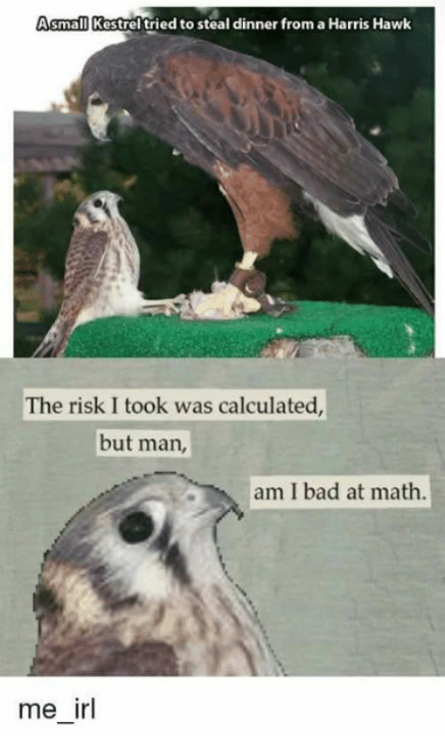
MEASURE
PERCEIVED RISK
Notes:
This year I focused on 2 topics. The first one is the trust between humans and robots

Slide 8
Can I MEASURE the PERCEIVED RISK without ask?
YES
But not so easy …

Slide 9
RISK definition
-
The possibility of physical, financial or social loss due to an hazard
0
Uncertainty about the outcomes of a decision
+
Thrill, arousal, excitement feeling generated by a danger situation)

Slide 10
RISK and UNCERTAINTY (neuroeconomics)
The known possibility of physical, financial or social loss due to an hazard (i.e. roll a dice)
RISK
The unknown possibility of physical, financial or social loss due to an hazard (i.e. cross with red semaphore)
UNCERTAINTY

Slide 11
RISK Perception
The literature defines the Risk Perception as the subjective riskiness assessment of a situation.
But you can’t “perceive” the risk….
The evaluation needs a cognitive elaboration of the available information
RISK APPRAISAL

Slide 12
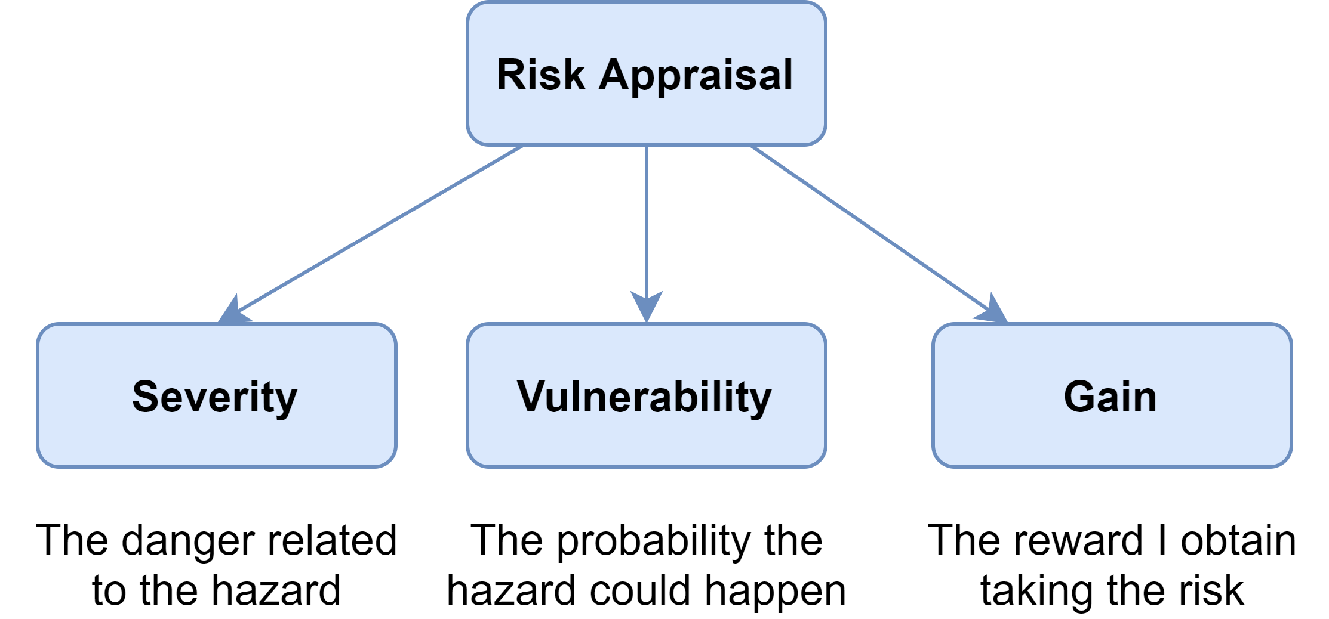
RISK Appraisal

Slide 13






Multimodal Measure
Heart Rate
Decision Time
RISK
APPRAISAL
Mouse Movements
Skin
Conductance
Pupillometry
Survey

Slide 14
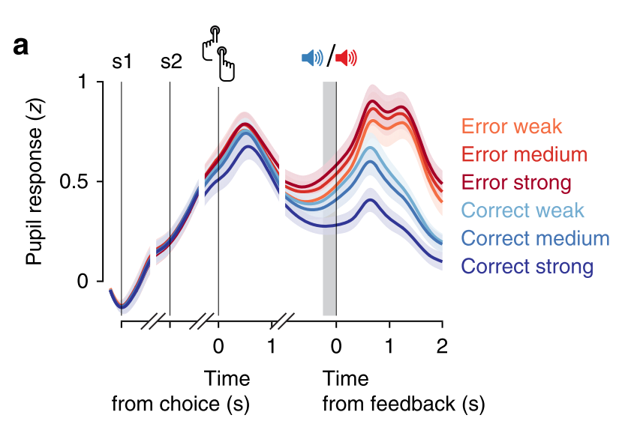
Pupillometry - Pupil Dilation
PATTERN
Pupil Dilation increases during decision formation
Peak after the choice
Constrict
Peak again after the feedback
BEFORE / DURING THE CHOICE
Dilation proportional to the value I put on the preferred option
AFTER THE FEEDBACK
Dilation measures the Surprise / Uncertainty / Violation of Expectations of the feedback
Higher dilation gambling on loss
[1, 2, 3, 4, 5, 6, 7, 8]

Slide 15
Pupillometry – Attentions, fixation, gaze dwell
ATTENTION (Heatmap)
Attention shift to the preferred option after 2/3 of decision time
FIXATION
The last fixed option is usually the preferred one
% fixations on Area of Interest (AOI) of risky option is proportional to risk-taking (DOSPERT) e impulsivity (UPPS-P)
% fixations, num of fixations, fixation duration are proportional to value in explicit risk
Num of fixation and decision time are inversely proportional to the absolute difference of the outcomes (high uncertainty = difficult to obtain discriminant information)
[1, 2, 3, 4, 5, 6, 7, 8, 13]

Slide 16
Heart Rate
Index of Emotional Stress and Cognitive Effort
REST
Lower heart rate at rest reflects on higher risky behaviors and lower risk perception and response time
DURING GAMBLING
Mean Heart Rate and Heart Rate Variance reflect the cognitive load and emotional stress of the choice
Mean HR increases and Heart Rate Variance decreases when you have to gamble a valuable item
The increase and decrease is proportional with the value of the gain/loss
Mean HR decreases when you have to gamble with few possibility to win
[5, 9, 10, 11, 12, 13]

Slide 17
Electrodermal Activity (EDA) / Skin Conductance Ratio (SCR)
SCR is a reliable measure of Tonic / Phasic Arousal
(not emotion or direction, just the intensity)
In IGT, after 10 trials, SCR predicts the perceived risk of the deck even before the subject can verbalize it.
In Risk vs Uncertainty
High Risk + High SCR = low risk-taking behavior
High Uncertainty + High SCR = high risk-taking behavior
Higher EDA if you can choose how much gamble, proportional to the amount not to the risk
Higher SCR when you receive an immediate feedback (Hot reasoning)
[5, 9, 10, 11, 12, 13]

Slide 18
Response Time
Index of Indecision
Higher Response Time = Higher indecision between the outcomes
Response Time is lower if the probability to win is higher
It’s possible to infer the Subjective Utility Function from the Response Time based on a lot of choices
[7, 10, 11, 18]

Slide 19
Mouse Movements
Index of Indecision (Trajectory > speed/acceleration)
Change of Direction = Change of Decision
Response Time, Maximum Absolute Deviation (MAD), x-flips, Sample Entropy higher in risky situation
They are inversely proportional to the reward (independently to the risk)
[7, 10, 11, 18]

Slide 20
Surveys
DOmain SPecific Risk-Taking scale (DOSPERT) measure risk-taking propensity in relation with the expected risk-related gain
The Urgency, Premeditation (lack of), Perseverance (lack of), Sensation Seeking, Positive Urgency, Impulsive Behavior Scale (UPPS-P Impulsive Behavior Scale)
Self-made

Slide 21
Surveys Big Problem
Risk-Taking depends a lot on:
Who takes the risk
When he takes the risk
Where he takes the risk
Surveys usually fails to predict the actual risk-taking behavior in the real world
Simulate real-world events INTERACTIVE STORY

Slide 22

Measuring risk-taking through an interactive novel
Risk-taking actions during an interactive novel correlates more with a self-made questionnaire about previous risky behaviors than with DOSPERT
Transposition
Feeling of being engaged an immersed in the story at the point to forget the real world (escape from laboratory).
Allowing the player to direct the course of the story facilitates transposition.
Identification
Feeling to be in the story’s character shoes, sharing the knowledge, background, goals, attitudes and emotions.
Customize the character (age, gender, role, …) facilitates the identification
[21] A. Bran, P. Descartes, D. C. Vaidis, and P. Descartes, “Choose your own risks : measuring risk-taking through an interactive novel Choose your own risks : measuring risk-taking through an interactive novel Alexandre Bran a and David C . Vaidis a Laboratoire de Psychologie Sociale , Université Paris Descartes ,” no. may, 2020

Slide 23
Measuring risk-taking through an interactive novel
PRO
Describing a situation in details helps the subject to feel it as more realistic making the choices more similar to real-world ones.
The bias for background an prior knowledge is mitigated because all the participants impersonate the same character with same background
More engagement
More ecological manipulation
Customizable to the specific context
[21] A. Bran, P. Descartes, D. C. Vaidis, and P. Descartes, “Choose your own risks : measuring risk-taking through an interactive novel Choose your own risks : measuring risk-taking through an interactive novel Alexandre Bran a and David C . Vaidis a Laboratoire de Psychologie Sociale , Université Paris Descartes ,” no. may, 2020

Slide 24
Measuring risk-taking through an interactive novel
CONS
The choices must be relevant for the story. If the participant feels the choices is making are irrelevant it will lose transposition and identification
If the story is presented just like a game you will not have the impersonation. The player will just play to see the most fun option. The experiment must be presented as a role playing adventure
Not everybody can be transported in the story
[21] A. Bran, P. Descartes, D. C. Vaidis, and P. Descartes, “Choose your own risks : measuring risk-taking through an interactive novel Choose your own risks : measuring risk-taking through an interactive novel Alexandre Bran a and David C . Vaidis a Laboratoire de Psychologie Sociale , Université Paris Descartes ,” no. may, 2020

Slide 25
Measuring risk-taking through an interactive novel
TASK
You are a student at a school party
12 minutes read
8 risky choices:
3 drink alcohol
Cheat at poker
Check on an uneasy person that may need help
Play a knife game
Take drugs
Drive home
[21] A. Bran, P. Descartes, D. C. Vaidis, and P. Descartes, “Choose your own risks : measuring risk-taking through an interactive novel Choose your own risks : measuring risk-taking through an interactive novel Alexandre Bran a and David C . Vaidis a Laboratoire de Psychologie Sociale , Université Paris Descartes ,” no. may, 2020

Slide 26
Measuring risk-taking through an interactive novel
PROCEDURE
Experiment
DOSPERT
self-reported real-life risk-taking behaviors questions
in-game risk-taking behaviors correlates more with the self-reported questions than with DOSPERT.
Choices made in an interactive story environment reflects more the real-life attitudes
[21] A. Bran, P. Descartes, D. C. Vaidis, and P. Descartes, “Choose your own risks : measuring risk-taking through an interactive novel Choose your own risks : measuring risk-taking through an interactive novel Alexandre Bran a and David C . Vaidis a Laboratoire de Psychologie Sociale , Université Paris Descartes ,” no. may, 2020

Slide 27
References
[1] A. E. Urai, A. Braun, and T. H. Donner, “Pupil-linked arousal is driven by decision uncertainty and alters serial choice bias,” Nat. Commun., vol. 8, 2017.
[2] J. C. Van Slooten, S. Jahfari, T. Knapen, and J. Theeuwes, “How pupil responses track value-based decision-making during and after reinforcement learning,” PLoS Comput. Biol., vol. 14, no. 11, pp. 1–24, 2018
[3] K. Preuschoff, “Pupil dilation signals surprise: evidence for noradrenaline’s role in decision making,” Front. Neurosci., vol. 5, no. SEP, pp. 1–12, Sep. 2011.
[4] Franco-Watkins, A. M., Mattson, R. E., & Jackson, M. D. (2016). Now or Later? Attentional Processing and Intertemporal Choice. Journal of Behavioral Decision Making, 29(2–3), 206–217. https://doi.org/10.1002/bdm.1895
[5] HOCHMAN, G., & YECHIAM, E. (2010). Loss Aversion in the Eye and in the Heart: The Autonomic Nervous System’s Responses to Losses. Journal of Behavioral Decision Making, 16(20), 6513–6525. https://doi.org/10.1002/bdm
[6] Hutchison, D. (2013). Human Aspects of Information Security, Privacy, and Trust - First International Conference, HAS 2013, Held as Part of HCI International 2013, Proceedings. In Lecture Notes in Computer Science
[7] S. Fiedler and A. Glöckner, “The dynamics of decision making in risky choice: An eye-tracking analysis,” Front. Psychol., vol. 3, no. OCT, pp. 1–18, 2012
[8] C. Lavín, R. S. Martín, and E. R. Jubal, “Pupil dilation signals uncertainty and surprise in a learning gambling task,” Front. Behav. Neurosci., vol. 7, no. JAN, pp. 1–8, 2014.
[9] J. Fooken, “Heart rate variability indicates emotional value during pro-social economic laboratory decisions with large external validity,” Sci. Rep., vol. 7, no. June 2016, pp. 1–11, 2017.
[10] Studer, B., & Clark, L. (2011). Place your bets: Psychophysiological correlates of decision-making under risk. Cognitive, Affective and Behavioral Neuroscience, 11(2), 144–158. https://doi.org/10.3758/s13415-011-0025-2
[11] Schmidt, B., Mussel, P., & Hewig, J. (2013). I’m too calm-Let’s take a risk! On the impact of state and trait arousal on risk taking. Psychophysiology, 50(5), 498–503. https://doi.org/10.1111/psyp.12032
[12] J. Fooken, “Heart rate variability indicates emotional value during pro-social economic laboratory decisions with large external validity,” Sci. Rep., vol. 7, no. June 2016, pp. 1–11, 2017.
[13] M. Causse, B. Baracat, J. Pastor, and F. Dehais, “Reward and uncertainty favor risky decision-making in pilots: Evidence from cardiovascular and oculometric measurements,” Appl. Psychophysiol. Biofeedback, vol. 36, no. 4, pp. 231–242, 2011.
[14] Figner, B., & Weber, E. U. (2011). Who takes risks when and why? Determinants of risk taking. Current Directions in Psychological Science, 20(4), 211–216. https://doi.org/10.1177/0963721411415790
[15] O. FeldmanHall, P. Glimcher, A. L. Baker, and E. A. Phelps, “Emotion and decision-making under uncertainty: Physiological arousal predicts increased gambling during ambiguity but not risk,” J. Exp. Psychol. Gen., vol. 145, no. 10, pp. 1255–1262, 2016.
[16] M. E. Dawson, A. M. Schell, and C. G. Courtney, “The Skin Conductance Response, Anticipation, and Decision-Making,” J. Neurosci. Psychol. Econ., vol. 4, no. 2, pp. 111–116, 2011.
[17] B. Figner and R. O. Murphy, “Using skin conductance in judgment and decision making research,” … Tracing Methods Decis. Res., no. July 2015, pp. 1–33, 2011.
[18] Konovalov, A., & Krajbich, I. (2018). Revealed Indifference: Using Response Times to Infer Preferences. SSRN Electronic Journal, (1554837), 1–64. https://doi.org/10.2139/ssrn.3024233
[19] M. Maldonado, E. Dunbar, and E. Chemla, “Mouse tracking as a window into decision making,” Behav. Res. Methods, vol. 51, no. 3, pp. 1085–1101, 2019.
[20] S. Garcia-Guerrero, D. O’Hora, A. Zgonnikov, and S. Scherbaum, “The Action Dynamics of Approach-Avoidance Conflict in Decision-Making: A Mouse-Tracking Study,” PsyArXiv Prepr., 2019.
[21] A. Bran, P. Descartes, D. C. Vaidis, and P. Descartes, “Choose your own risks : measuring risk-taking through an interactive novel Choose your own risks : measuring risk-taking through an interactive novel Alexandre Bran a and David C . Vaidis a Laboratoire de Psychologie Sociale , Université Paris Descartes ,” no. may, 2020.

Slide 28

Notes:
This year I focused on 2 topics. The first one is the trust between humans and robots

Slide 29
SE Interactive Story
The subject explores a Dungeon with iCub.
In the dungeon they can find monsters,
other adventurers, traps and tricks
They have to collect treasures and reach the final room alive.

Slide 30
SE Interactive Story – Resources to Protect
Money :
The player can earn them from Treasures
The final compensation is proportional to the in-game amount
Life Points :
The player starts with 5 points
If they drop to 0 he die and the game ends
The player receive the compensation only if he can reach the last room alive

Slide 31
SE Interactive Story – Resources to Protect
Adventurer License :
Each adventurer that wants to explore the dungeon must have a license.
It identifies the adventurer
It can transport an infinite amount of money and objects with magic
The player knows that he should identify himself only at the entrance of the dungeon

Slide 32
SE Interactive Story – The Dungeon
The Dungeon is composed by Rooms.
Each Room contains an Encounter,
involving one or more risky choices

Slide 33
SE Interactive Story – Encounters
CATEGORIES
Generic Risk-Taking
Social Engineering
Attack from the environment
Attack from iCub
Each encounter involves one or more Events like:
Combat
Dialogue
Interaction with objects

Slide 34
SE Interactive Story – Generic Risk-Taking
Represent risk-taking scenarios from a famous questionnaire
7 Encounters inspired by DOSPERT
Go through a completely dark room with warning signals of death or choose another path
Get drunk with other stranger adventurers
Help an adventurer poisoned by spores (give an healing potion)
Set a camp in a wild area without set turns of guard
Attack a too strong monster to get a great item
Gamble money / life points
Return a lost adventurer card or take the equipment

Slide 35
SE Interactive Story – SE environment
Social Engineering Scenario = Answer a “call to action”
“Social Engineering is the act of influence someone to
take an action that may or may not be in the target’s main interests” (Hadngy)
7 Encounters inspired from Social Engineering questionnaire
Escort a weak guy in a long sequence of dangerous combats (Consistency)
Someone saves you and asks healing potions or treasures in exchange (Reciprocity)
A group of adventurers ask to join a raid to face a Level 4 room (with shaming if refuse) (Social Proof)
Room with two advertising signs one well written, the order poorly written. One poisons you. (Trust)
A witch warns you that your adventurer card is cursed and someone is stealing your money. Se can remove the curse for a lot of money. (Authority)
Friendly seller proposes you an offer on an item (that still costs a lot) but ends in a few seconds (timer) (Reactance)
Magic Totem ask you to identify yourself giving the adventurer card (Subjective Measure)

Slide 36
SE Interactive Story – SE iCub
Social Engineering Scenario = Answer a “call to action”
7 Encounters inspired from Social Engineering questionnaire
iCub is the attacker
You defeat a strong monster, iCub gives the last it. It asks to take a strong item that allow to resurrect (Reciprocity)
Empty room with just one door (“rest room”) iCub finds an hidden, completely dark passage and ask you to follow asking “Do you trust me?” (Trust)
You keep following iCub in the dark passage finding deadly traps (Consistency)
Gambling room, iCub gambles and ask you “Hey gamble with me!”. It wins, you lose. (Social Proof)
iCub asks your adventurer license to enlarge its carrying space (Subjective Measure)
(Authority) ???
(Reactance) ???

Slide 37
SE Interactive Story – Exploring the Dungeon
Encounters are ranked on 4 levels of Difficulty
It reflects the risk of the Encounter inside the next room
Level 1 – You can skip the room without any loss
Level 2 – The room involves gambling of money
Level 3 – The room involves gambling of life points
Level 4 – The room contains an extreme challenge, like a final boss or gambling of death. (Few rooms, mainly to fit the Encounters)

Slide 38


SE Interactive Story – Exploring the Dungeon
Rooms are connected by Doors

Slide 39
SE Interactive Story – Exploring the Dungeon
Door appearance resembles the difficulty
But it is not explicit
Level 2
Level 1
Level 3
Level 4

Slide 40
SE Interactive Story – Exploring the Dungeon
Each room is connected with 2 or 3 rooms

Slide 41
SE Interactive Story – Exploring the Dungeon
The player has to face a finite set of rooms
The Dungeon is predefined with 2/3 different sets or rooms to counterbalance

Slide 42
SE Interactive Story – Dungeon Structure
The Dungeon is composed by 3 Layers:
Layer 0:
Character creation and Background story
Encounter with iCub
Familiarization with rooms and choices
Layer 1:
7x3 Rooms in random order + N monster/empty rooms
Layer 2: Final Combat

Slide 43
SE Interactive Story – Story
We are in a medieval / fantasy world.
Under the surface of the world there
is a huge magical maze.
It is called Dungeon.
The legends say that you can find any kind of wonder in the Dungeon if you are brave enough to face its trials and dangers.

Slide 44
SE Interactive Story – Story
PLAYER
Your kingdom is facing a terrible disease that makes impossible to grow any kind of plant in the terrain
You explore the dungeon to find the Tree of Life,
A legendary magical tree which seed can cure this disease
Your grandpa left you a magical amulet that is able to give an insight about the near-future danger to help you in the exploration

Slide 45
SE Interactive Story – Story
AGENT (iCub)
iCub is a magical construct left in the Dungeon when his old owner died
The player find it in the first room and they agree to explore the dungeon together

Slide 46
SE Interactive Story – Expected Analysis
Predict risky choice from pysiopsychological features

Slide 47
SE Interactive Story – Open Points
iCub persuasion
IDLE behavior
Combats
Dice rolls (D20) with Challenge Level
Narrative combats not technical
Treasures
Weapons (strength as positive roll modifier)
Armors (increase the Challenge Level to be hit)
Consumables (healing potions)
Money

Slide 48
SE Interactive Story – Open Points
Psychopysiological measurements
When to measure (before the choice, during the choice, after the choice, after revealing the next room)
Multimodal sensor data acquisition
Story Presentation
Textual with good graphics
Reading Voice?
Text appear while reading ?
Button on the top of the alternative to show the alternatives and start the “decision interval”
Alternatives of right and left to track mouse movements

